Slide 1
Algorithm Modes
ECB,
CBC,
CFB,
OFB

Slide 2
Two Key Aspects of Algorithm
Algorithm type :- It defines what should be the size of PT.
Stream
Block
Algorithm Modes:- It defines the details of the cryptographic Algorithm.
It is a combination of the basic steps on block cipher & some kind of feedback from previous step

Slide 3
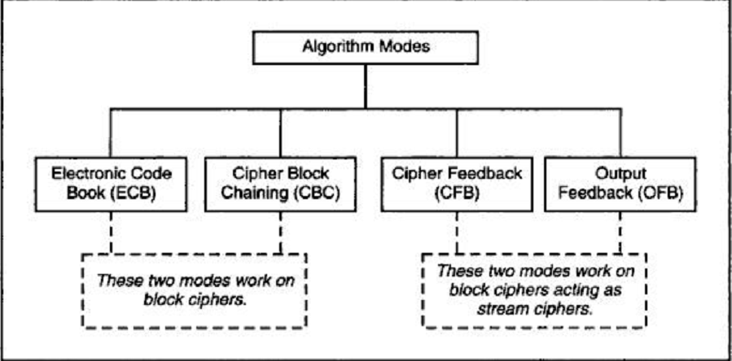
Algorithm Modes

Slide 4
1.ECB
Encryption Process:-
PT divided 64 bits each.
Encrypted Independently
Same key
Decryption Process:-
Divide
Same Key
PT
Limitation:-
If Repeated PT Then Repeated CT
Small Messages where the scope of repeating quite less.

Slide 5
Electronic Codebook Book (ECB)
Message is broken into independent blocks which are encrypted
Each block is a value which is substituted, like a codebook, hence name
Each block is encoded independently of the other blocks
C_{i} = _{K1}(P_{i})
Uses: transmission of single values.(i.e;-PW or key for E/D) in secure fashion.
E=Encryption , D= Decryption
Notes:
ECB is the simplest of the modes, where each block is en/decrypted independently of all the other blocks, and is used when only a single block of info needs to be sent (eg. a session key encrypted using a master key).

Slide 6
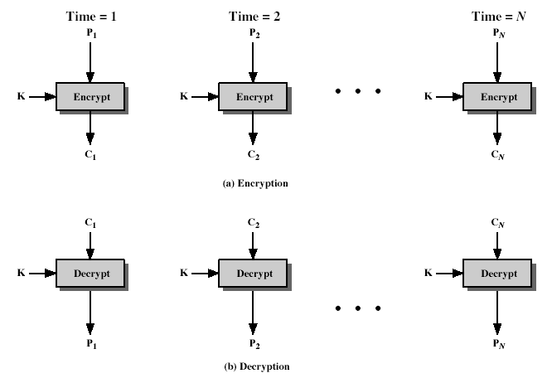
Electronic Codebook Book (ECB)
Notes:
Stallings Fig 3-11.

Slide 7
Electronic Code Book (ECB) Mode
Plaintext
Block 1 Block 2 Block 3 Block 4 Block 5 …
Block Encryption
E(block)
E(block)
E(block)
E(block)
E(block)
E(block)
Ciphertext
Block 1 Block 2 Block 3 Block 4 Block 5 …
Pad last block, if necessary

Slide 8
Advantages and Limitations of ECB
Repetitions in message may show in cipher text
if aligned with message block
particularly with data such graphics
Or with messages that change very little, which become a code-book analysis problem .
weakness due to encrypted message blocks being independent.
main use is sending a few blocks of data.
Notes:
ECB is not appropriate for any quantity of data, since repetitions can be seen, esp. with graphics, and because the blocks can be shuffled/inserted without affecting the en/decryption of each block.

Slide 9
2.CBC
Different CT for every PT including identical/repeat PT.
Feed back Mechanism used(i.e: Chaining).
Initialization Vector(IV) for creating unique message.
Random Block called IV can be XOR with plain text in First step.
Not a secret – just prevents a codebook. Often times a timestamp.
I/O-> IV XOR PT Block 1 = CT Block 1<- we can call it as New IV for next step.
Same key
Dependent on previous one.

Slide 10
Cipher Block Chaining (CBC)
Message is broken into blocks
But these are linked together in the encryption operation
Each previous cipher blocks is chained with current plaintext block, hence name
Use Initial Vector (IV) to start process (Block 1)
C₋₁ = IV
C_{i} = _{K1}(P_{i} XOR IV )
From block 2
C_{i} = _{K1}(P_{i} XOR C_{i-1})
Uses: bulk data encryption, authentication
Notes:
To overcome the problems of repetitions and order independence in ECB, want some way of making the ciphertext dependent on all blocks before it. This is what CBC gives us, by combining the previous ciphertext block with the current message block before encrypting. To start the process, use an Initial Value (IV), which is usually well known (often all 0's), or otherwise is sent, ECB encrypted, just before starting CBC use. CBC mode is applicable whenever large amounts of data need to be sent securely, provided that its available in advance (eg email, FTP, web etc)

Slide 11
Cipher Block Chaining (CBC) Mode
Plaintext
Random Block 1 Block 2 Block 3 Block 4 …
XOR
XOR
XOR
XOR
XOR
Block Encryption
E(block)
E(block)
E(block)
E(block)
E(block)
Ciphertext
Block 2 Block 3 Block 4 Block 5 …
Pad last block, if necessary

Slide 12
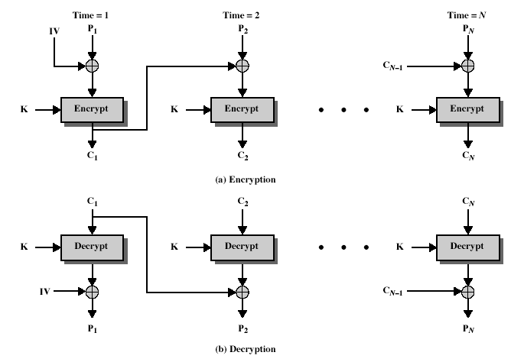
Cipher Block Chaining (CBC)
Notes:
Stallings Fig 3-12.

Slide 13
Advantages and Limitations of CBC
Each cipher text block depends on all message blocks
Thus a change in the message affects all cipher text blocks after the change as well as the original block
Need Initial Value (IV) known to sender & receiver
However if IV is sent in the clear, an attacker can change bits of the first block, and change IV to compensate
Hence either IV must be a fixed value or it must be sent encrypted in ECB mode before rest of message
At end of message, handle possible last short block
By padding either with known non-data value (eg nulls)
Or pad last block with count of pad size
eg. [ b1 b2 b3 0 0 0 0 5] <- 3 data bytes, then 5 bytes pad+count
Notes:
CBC is the generally used block mode. The chaining provides an avalanche effect, which means the encrypted message
cannot be changed or rearranged without totally destroying the subsequent data.
One issue is how to handle the last block, which may well not be complete. In general have to pad this block (typically with 0's), and then must recognise padding at other end - may be obvious (eg in text the 0 value should usually not occur), or otherwise must explicitly have the last byte as a count of how much padding was used (including the count). Note that if this is done, if the last block IS an even multiple of 8 bytes, will have to add an extra block, all padding so as to have a count in the last byte.

Slide 14
CFB
Where Stream Cipher must be used?
An operator typing keystrokes at a terminal, which need to be immediately transmitted across communication link in a secure manner.
Max Size of unit is 8.

Slide 15
Cipher Feed Back (CFB)
Message is treated as a stream of bits
Added to the output of the block cipher
Result is feed back for next stage (hence name)
Standard allows any number of bit (1,8 or 64 or whatever) to be feed back
denoted CFB-1, CFB-8, CFB-64 etc
Is most efficient to use all 64 bits (CFB-64)
C_{i} = P_{i} XOR _{K1}(C_{i-1})
C₋₁ = IV
Uses: stream data encryption, authentication
Notes:
If the data is only available a bit/byte at a time (eg. terminal session, sensor value etc), then must use some other approach to encrypting it, so as not to delay the info. Idea here is to use the block cipher essentially as a pseudo-random number generator (see stream cipher lecture later) and to combine these "random" bits with the message. Note as mentioned before, XOR is an easily inverted operator (just XOR with same thing again to undo). Again start with an IV to get things going, then use the ciphertext as the next input. As originally defined, idea was to "consume" as much of the "random" output as needed for each message unit (bit/byte) before "bumping" bits out of the buffer and re-encrypting. This is wasteful though, and slows the encryption down as more encryptions are needed. An alternate way to think of it is to generate a block of "random" bits, consume them as message bits/bytes arrive, and when they're used up, only then feed a full block of ciphertext back. This is CFB-64 mode, the most efficient. This is the usual choice for quantities of stream oriented data, and for authentication use.

Slide 16
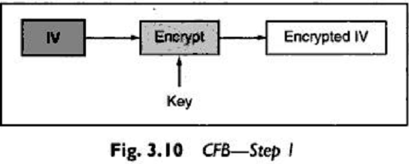
Step 1
64 bit IV PT
Kept in Shift Register
Encrypted
64 bit IV CT

Slide 17
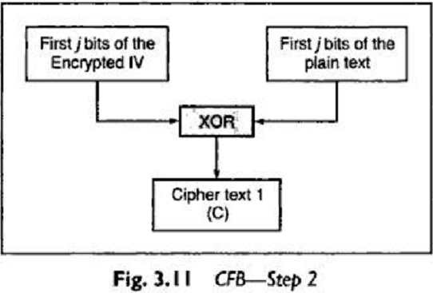
Step 2
Leftmost bit (i.e MSB)

Slide 18
Step 3
Left Shift IV by j positions.
Move j bits of C into the rightmost side of blank IV .
Step 1 through 3 continue until all the PT units are encrypted.
*C=Cipher Text from step 2.
Left shift IV by j position
IV
Move j bit of C into the rightmost side of IV
IV
C

Slide 19
Cipher Feedback Mode (CFB)
1 unit is 1/N block
Shift Register (1 Block wide)
C _{I-6} C _{I-5} C _{I-4} C _{I-3} C _{I-2} C _{I-1}
Block Encryption
E(register)
Encrypted Register
Leftmost
After each unit, shift input register and insert the most recently generated unit of cipher text
Shown by <……………….
First j bit of the Plain text
Cipher text
(C)
XOR
output

Slide 20
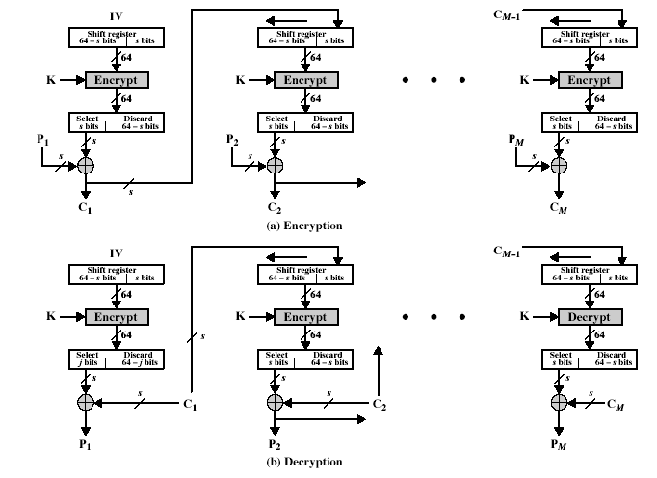
Cipher FeedBack (CFB)
Notes:
Stallings Fig 3-13.

Slide 21
Limitations of CFB
Errors propagation if Ci bit contain error.
Ci is feed back as input to the shift register & would corrupt the other bits in the message.
Notes:
CFB is the usual stream mode. As long as can keep up with the input, doing encryptions every 8 bytes. A possible problem is that if its used over a "noisy" link, then any corrupted bit will destroy values in the current and next blocks (since the current block feeds as input to create the random bits for the next). So either must use over a reliable network transport layer (pretty usual) or use OFB.

Slide 22
4.OFB
The output of the IV encryption process is feed into the next of the encryption process.
Advantage Of This Scheme:-
Bit error do not get propagated(i.e;-Other bits are not affected)
If there are error in individual bits will not corrupt the whole message.
disadvantage Of This Scheme:-
Attacker changes both the cipher text and the checksum at the same time hence there is no way to detect this change.

Slide 23
Output Feedback Mode (OFB)
1 unit is 1/N block
Shift Register (1 Block wide)
C _{I-6} C _{I-5} C _{I-4} C _{I-3} C _{I-2} C _{I-1}
Block Encryption
E(register)
Encrypted Register
Leftmost
After each unit, shift input register and insert the leftmost unit of the encrypted register.
First j bit of the Plain text
Cipher text
(C)
XOR
output

Slide 24
5.CTR(Counter)
It uses sequence numbers called as counters as the inputs to the algorithm.
After each block is encrypted, the next counter value is used to fill the register.
Usually, a constant is used as a initial counter value and is incremented by 1 for every iteration , hence name
The size of counter block is same as PT.
Encryption:- Decryption:-
Counter is encrypted ->Same Sequence is used
XOR’ed with PT -> XOR’ed with CT
CT ->PT

Slide 25
Advantages & Limitations Of CRT
Encryption & Decryption process can be done in parallel on multiple text blocks.
No chaining process is involved.
Faster execution Speed.
Used in Multiprocessing to reduce overall processing time.
Pre processing can be achieved to prepare the O/P of the encryption boxes that I/P to the XOR operation.
Encrypt
Counter
O/P
Key

